Slide 1
Windows Azure

Slide 2
What is Cloud Computing?
Cloud computing is the delivery of computing capabilities as a service, making access to IT resources like compute power, networking and storage.
As with any utility, you generally only pay for what you use with cloud computing.
One can harness the power of massive data centers without having to build, manage or maintain costly, complex IT building blocks.
With the cloud, much of the complexity of IT is abstracted away, letting you focus just on the infrastructure, data and application development that matter s to business.

Slide 3
What are the main attributes of cloud computing?
Pooled Resources
Cloud computing takes the basic concept of server virtualization to the next level, allowing you to dynamically provision and scale applications whenever you need.
There’s no need to deal with adding more servers or additional networking, everything is ready to use in the cloud.

Slide 4
What are the main attributes of cloud computing?
Self-Service
With the cloud, you can get the computing resources you need without having to procure, provision, and manage infrastructure on a per-application, ad-hoc basis.
Elastic
The cloud lets you scale up (or scale down) dynamically to meet the changing needs of your business.

Slide 5
What are the main attributes of cloud computing?
Usage Based
Pay for only what you use, when you need to use it.
Economics
Since you don’t have to build out or manage infrastructure with cloud computing, IT costs for everything from new projects to new companies are greatly reduced.

Slide 6
What are the benefits of the cloud?
Focus
Cloud computing lets you focus on the infrastructure, data and applications that really matter to your business.
Agility
When you use the cloud, not only can you get to market more quickly – but gain insights, gather feedback, and iterate in the time it used to take to just get your environment provisioned.

Slide 7
WORKING MODELS
There are certain services and models working behind the scene making the cloud computing feasible and accessible to end users.
Following are the working models for cloud computing:
Service Models
Deployment Models

Slide 8
SERVICE MODELS
Infrastructure as a Service (IaaS)
Platform as a Service (PaaS)
Software as a Service (SaaS)

Slide 9
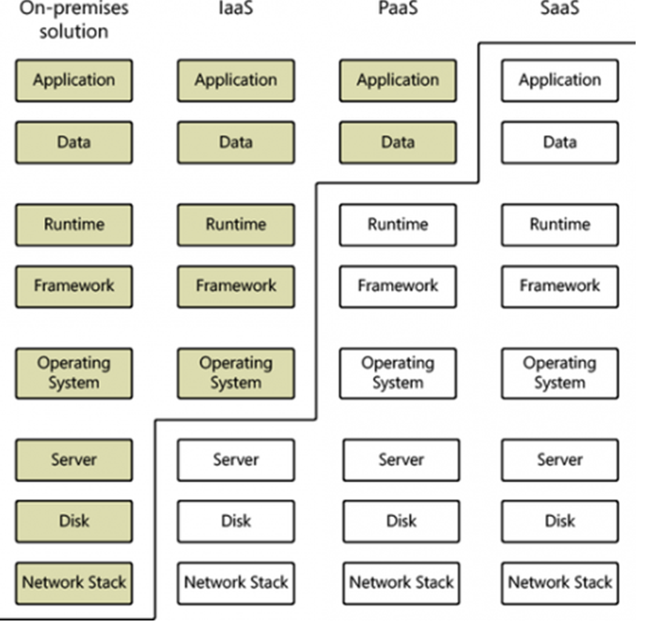
IaaS, PaaS, SaaS

Slide 10
SERVICE MODELS …
Infrastructure-as-a-Service (IaaS)
With Infrastructure as a Service, the lower levels of the IT stack are delivered as a service, freeing up a developer from much of the complexity of provisioning physical machines and configuring networks.
You can easily provision virtual machines in a highly scalable and available cloud environment, develop and test solutions, then deploy applications to production.

Slide 11
SERVICE MODELS …
Platform-as-a-Service (PaaS)
With Platform as a Service, everything from network connectivity through the runtime is provided.
PaaS makes development easy by providing additional support for application services and management of the operating system, including updates.
With PaaS, you can focus on the business logic of application and quickly move applications from concept to launch.

Slide 12
SERVICE MODELS …
Software-as-a-Service (SaaS)
With Software as a Service, a single finished application or suite of applications is delivered through a web browser, abstracting away the underlying components of the IT stack including application code.

Slide 13
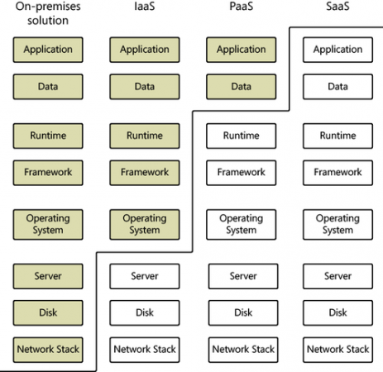
IaaS, PaaS, SaaS

Slide 14
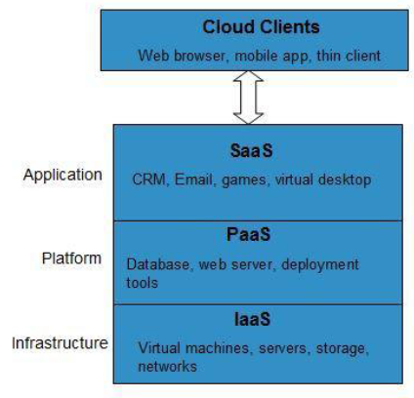
SERVICE MODELS…

Slide 15
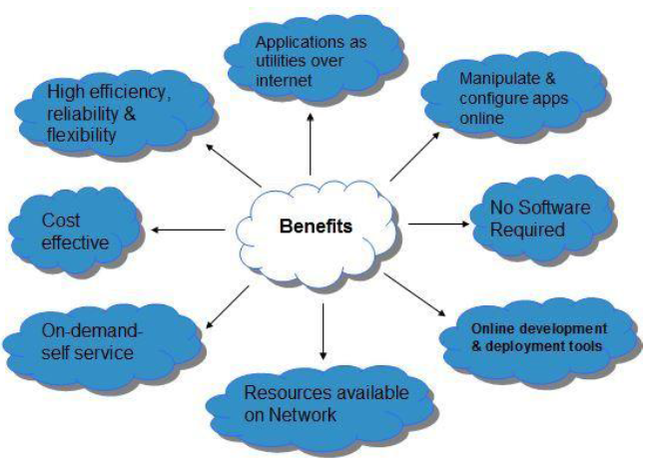
SERVICE MODELS…

Slide 16
DEPLOYMENT MODELS
Deployment models define the type of access to the cloud, i.e., how the cloud is located?
Cloud can have any of the four types of access:
Public
Private
Hybrid
Community.

Slide 17
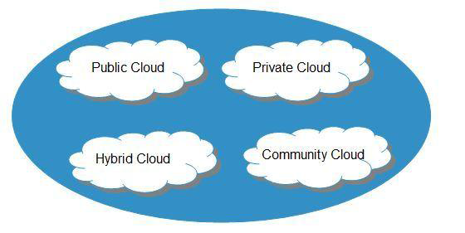

Slide 18
Public Cloud
The Public Cloud allows systems and services to be easily accessible to general public
e.g., Google, Amazon, Microsoft offers cloud services via Internet.

Slide 19
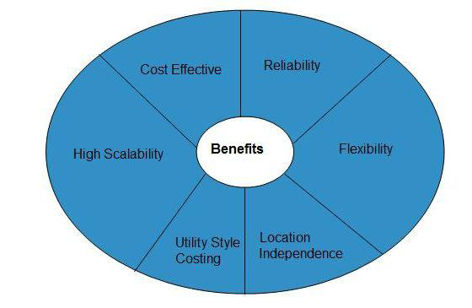
Benefits

Slide 20
Benefits…
COST EFFECTIVE
Since public cloud share same resources with large number of consumer, it has low cost.
RELIABILITY
Since public cloud employs large number of resources from different locations, if any of the resource fail, public cloud can employ another one.
FLEXIBILITY
It is also very easy to integrate public cloud with private cloud, hence gives consumers a flexible approach.

Slide 21
Benefits…
LOCATION INDEPENDENCE
Since, public cloud services are delivered through Internet, therefore ensures location independence.
UTILITY STYLE COSTING
Public cloud is also based on pay-per-use model and resources are accessible whenever consumer needs it.
HIGH SCALABILITY
Cloud resources are made available on demand from a pool of resources, i.e., they can be scaled up or down according the requirement.

Slide 22
Disadvantages
LOW SECURITY
In public cloud model, data is hosted off-site and resources are shared publicly, therefore does not ensure higher level of security.
LESS CUSTOMIZABLE
It is comparatively less customizable than private cloud.

Slide 23
Private Cloud
The Private Cloud allows systems and services to be accessible with in an organization.
The Private Cloud is operated only within a single organization. However, It may be managed internally or by third-party.

Slide 24
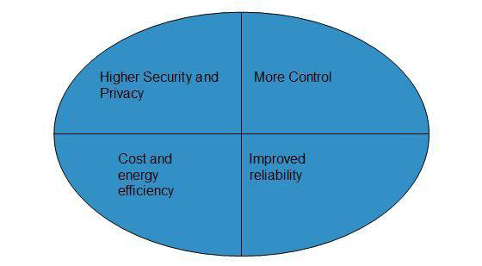
Benefits

Slide 25
Benefits
HIGHER SECURITY AND PRIVACY
Private cloud operations are not available to general public and resources are shared from distinct pool of resources, therefore, ensures high security and privacy.
MORE CONTROL
Private clouds have more control on its resources and hardware than public cloud because it is accessed only within an organization.
COST AND ENERGY EFFICIENCY
Private cloud resources are not as cost effective as public clouds but they offer more efficiency than public cloud.

Slide 26
Disadvantages
RESTRICTED AREA
Private cloud is only accessible locally and is very difficult to deploy globally.
INFLEXIBLE PRICING
In order to fulfill demand, purchasing new hardware is very costly.
LIMITED SCALABILITY
Private cloud can be scaled only within capacity of internal hosted resources.

Slide 27
Hybrid Cloud
The Hybrid Cloud is a mixture of public and private cloud.
Non-critical activities are performed using public cloud while the critical activities are performed using private cloud.

Slide 28
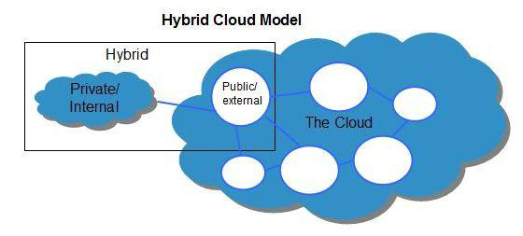

Slide 29
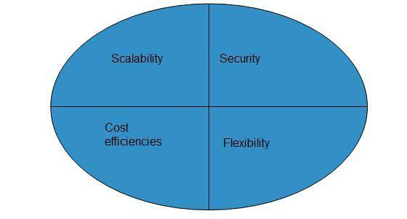
Benefits

Slide 30
Benefits…
SCALABILITY
It offers both features of public cloud scalability and private cloud scalability.
FLEXIBILITY
It offers both secure resources and scalable public resources.
COST EFFICIENCIES
Public cloud are more cost effective than private, therefore hybrid cloud can have this saving.
SECURITY
Private cloud in hybrid cloud ensures higher degree of security.

Slide 31
Disadvantages
NETWORKING ISSUES
Networking becomes complex due to presence of private and public cloud.
SECURITY COMPLIANCE
It is necessary to ensure that cloud services are compliant with organization's security policies.
INFRASTRUCTURAL DEPENDENCY
The hybrid cloud model is dependent on internal IT infrastructure, therefore it is necessary to ensure redundancy across data centers.

Slide 32
Community Cloud
The Community Cloud allows system and services to be accessible by group of organizations.
It shares the infrastructure between several organizations from a specific community.
It may be managed internally or by the third-party.

Slide 33
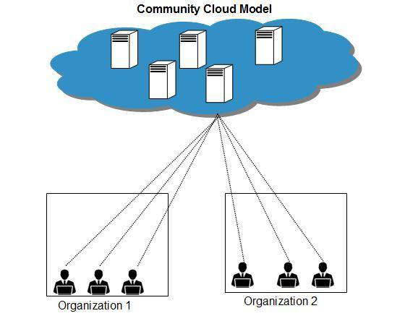

Slide 34
Benefits
COST EFFECTIVE
Community cloud offers same advantage as that of private cloud at low cost. Sharing Between Organizations Community cloud provides an infrastructure to share cloud resources and capabilities among several organizations.
SECURITY
Community cloud is comparatively more secure than the public cloud.
ISSUES
Since all data is housed at one location, one must be careful in storing data in community cloud because it might be accessible by others.
It is also challenging to allocate responsibilities of governance, security and cost.

Slide 35
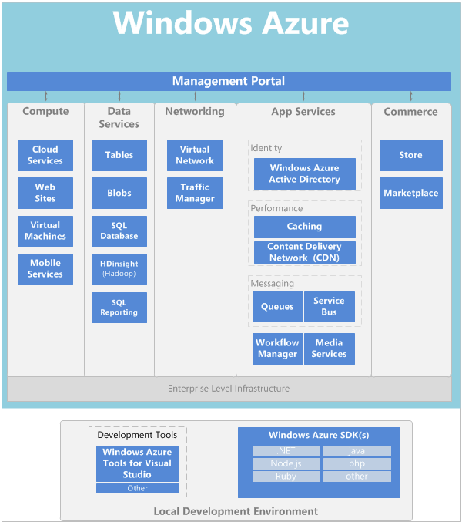

Slide 36
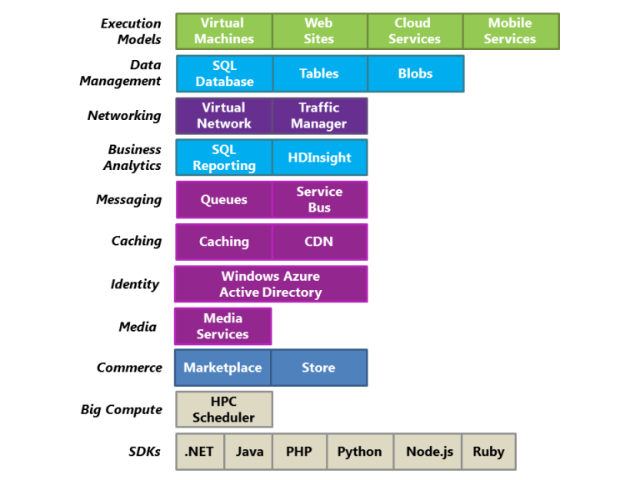
Azure Components

Slide 37
Execution Models
One of the most basic things a cloud platform does is execute applications. Windows Azure provides four options for doing this.
Each of these four approaches--Virtual Machines, Web Sites, Cloud Services, and Mobile Services--can be used separately.
One can also combine them to create an application that uses two or more of these options together.

Slide 38
Virtual Machines
The ability to create a virtual machine on demand, whether from a standard image or from one you supply, can be very useful.
Add the ability to pay for this VM only while it's running, and it's even more useful.
This approach, commonly known as Infrastructure as a Service (IaaS), is what Windows Azure Virtual Machines provides.

Slide 39
Virtual Machines
Windows Azure Virtual Machines offers a gallery of standard VHDs.
These include Microsoft-provided options, such as Windows Server 2008 R2, Windows Server 2012, and Windows Server 2008 R2 with SQL Server, along with Linux images provided by Microsoft partners. You're free to upload and create VMs from your own VHDs as well.

Slide 40
Virtual Machines
Wherever the image comes from, you can persistently store any changes made while a VM is running.
The next time you create a VM from that VHD, things pick up where you left off. It's also possible to copy the changed VHD out of Windows Azure, then run it locally.

Slide 41
Virtual Machines
Windows Azure VMs can be used in many different ways. You might use them to create an inexpensive development and test platform that you can shut down when you've finished using it.
You might also create and run applications that use whatever languages and libraries you like.
Those applications can use any of the data management options that Windows Azure provides, and you can also choose to use SQL Server or another DBMS running in one or more virtual machines.

Slide 42
Virtual Machines
Another option is to use Windows Azure VMs as an extension of your on-premises datacenter, running SharePoint or other applications.
To support this, it's possible to create Windows domains in the cloud by running Active Directory in Windows Azure VMs.

Slide 43
Cloud Services
Suppose you want to build a cloud application that can support lots of simultaneous users, doesn't require much administration, and never goes down.
You might be an established software vendor, for example, that's decided to embrace Software as a Service (SaaS) by building a version of one of your applications in the cloud.
Or you might be a start-up creating a consumer application that you expect will grow fast. If you're building on Windows Azure, which execution model should you use?

Slide 44
Cloud Services
Windows Azure Web Sites allows creating this kind of web application, but there are some constraints. You don't have administrative access, for example, which means that you can't install arbitrary software.
Windows Azure Virtual Machines gives you lots of flexibility, including administrative access, and you certainly can use it to build a very scalable application, but you'll have to handle many aspects of reliability and administration yourself.
What you'd like is an option that gives you the control you need but also handles most of the work required for reliability and administration.

Slide 45
Cloud Services
This is exactly what's provided by Windows Azure Cloud Services. This technology is designed expressly to support scalable, reliable, and low-admin applications, and it's an example of what's commonly called Platform as a Service (PaaS).
To use it, you create an application using the technology you choose, such as C#, Java, PHP, Python, Node.js, or something else. Your code then executes in virtual machines (referred to as instances) running a version of Windows Server.

Slide 46
Cloud Services
But these VMs are distinct from the ones you create with Windows Azure Virtual Machines.
For one thing, Windows Azure itself manages them, doing things like installing operating system patches and automatically rolling out new patched images. Windows Azure also monitors the VMs, restarting any that fail.

Slide 47
Cloud Services
You have two roles to choose from when you create an instance, both based on Windows Server. The main difference between the two is that an instance of a web role runs IIS, while an instance of a worker role does not.
Both are managed in the same way, however, and it's common for an application to use both. For example, a web role instance might accept requests from users, then pass them to a worker role instance for processing.
To scale your application up or down, you can request that Windows Azure create more instances of either role or shut down existing instances. And similar to Windows Azure Virtual Machines, you're charged only for the time that each web or worker role instance is running.

Slide 48
Cloud Services
Each of the four Windows Azure execution models has its own role to play.
Windows Azure Virtual Machines provides a general-purpose computing environment,
Windows Azure Web Sites offers low-cost web hosting.
Windows Azure Cloud Services is the best choice for creating scalable, reliable applications with low administration costs.

Slide 49
Mobile Services
If you are creating an app for a mobile device, Windows Azure Mobile Services accelerates development by providing turnkey way to store data in the cloud, authenticate users, and send push notifications. Native client libraries for Android, iOS, HTML/JavaScript, Windows Phone, and Windows Store make it easy to power apps available on all major mobile platforms.
An open and flexible REST API also enables you to use Mobile Services data and authentication functionality with apps on almost any platform. A single Mobile Service can back multiple client apps so you can provide a consistent user experience across devices.

Slide 50
Mobile Services
Mobile Services allows you to do simple provisioning and management of data stored in a SQL Database, authenticate users through well-known identity providers like Facebook, Twitter, Microsoft or Google account, and use notification services to deliver push notifications to your app.
A service can be scaled as an app becomes more popular, and monitoring and logging are supported.

Slide 51
Mobile Services
While you can certainly build the backend for a mobile app using Virtual Machines, Cloud Services or Web Sites, by opting for Mobile Services you can spend much less time writing the underlying service components.

Slide 52
Web Sites
One of the most common things that people do in the cloud is run web sites and web applications.
Windows Azure Virtual Machines allows this, but it still leaves you with the responsibility of administering one or more VMs.
What if you just want a web site where somebody else takes care of the administrative work for you?

Slide 53
Web Sites
This is exactly what Windows Azure Web Sites provides. This execution model offers a managed web environment using the Windows Azure Management portal as well as APIs.
You can move an existing web site into Windows Azure Web Sites unchanged, or you can create a new one directly in the cloud.
Once a web site is running, you can add or remove instances dynamically, relying on Windows Azure Web Sites to load balance requests across them. Windows Azure Web Sites offers both a shared option, where your web site runs in a virtual machine with other sites, and a standard option that allows a site to run in its own VM. The standard option also lets you increase the size (computing power) of your instances if needed.

Slide 54
Web Sites
Windows Azure Web Sites is intended to be useful for corporations, developers, and web design agencies. For corporations, it's an easy-to-manage, scalable, highly secure and highly available solution for runing presence web sites.
For development, it supports .NET, PHP, Node.js, and Python, along with SQL Database and MySQL (from ClearDB, a Microsoft partner) for relational storage.
It also provides built-in support for several popular applications, including WordPress, Joomla, and Drupal. The goal is to provide a low-cost, scalable, and broadly useful platform for creating web sites and web applications in the public cloud.

